Slide 1
“If you find yourself in a hole, stop digging.”
Will Rogers

Slide 2
BE RESILIENT
We’ll get through this together

Slide 3
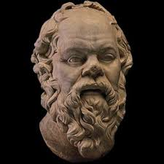
“The beginning of wisdom is in the definition of terms.”
Notes:
gw

Slide 4

What is stress??
Notes:
jp

Slide 5

Can we avoid stress??
Notes:
jp

Slide 6


Slide 7


Slide 8


Slide 9
LEAD 101
Principles and Practices of Leadership
Unit 4

Slide 10
Exploring the History of Leadership Studies
Developing a Personal Leadership Philosophy
Realizing Change
Leading by Serving
Making Decisions
Guiding Through Conflict
Articulating a Vision

Slide 12
“Fourscore and seven years ago
our fathers brought forth upon this continent
a new nation, conceived in Liberty,
and dedicated to the proposition that all men
are created equal.”
The Gettysburg Address
Abraham Lincoln
“If my cup won’t hold but a pint, and yours holds a quart, wouldn’t you be mean not to let me have my
little half measure full?”
Ain’t I a Woman
Sojourner Truth
Notes:
Complete speech is on p. 153 in the textbook
Delivered at the dedication of the National Cemetery at Gettysburg, PA, November 19, 1863
Ask student or students to read it, then ask “what is Lincoln’s vision?” – ask for deeper and deeper meaning; what chords within us does his address strike? That’s what effective articulation of a vision does.
Next show Henry V clip, Alice Paul in Iron Jawed Angels, MLK Jr I Have a Dream speech and discuss questions on following slide

Slide 13
Readings
Unit 4 Introduction
The Life of King Henry V
Vision and Meaning: Two Sides of the Same Coin

Slide 14
Unit 4 Introduction
Vision
  is an essential part of leadership.
  has the capacity to ignite hope, resolve and motivation in others.
  Is the factor that separates leadership from management.

Slide 15

King Henry V
https://www.youtube.com/watch?v=bvFHRNGYfuo

Slide 16
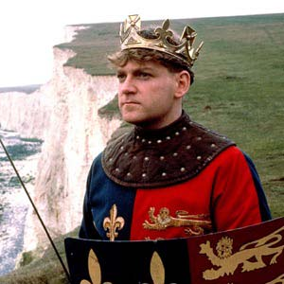

Slide 17
How was King Henry V an effective communicator?
How does he convince followers
to work against the odds?

Slide 18
Vision and Meaning: Two Sides of the Same Coin
James A. Vaughn examined the relationship between corporate vision, individual purpose and meaning.

Slide 19

Vision is “the loftiest future you can imagine…”

Slide 20
Individual Purpose
Organizational Purpose
Team
Purpose

Slide 21

“A shared vision is more important today than ever.”

Slide 22

Why is shared vision so important?
To keep good people
To sort abundance of information
To compete globally
To deal with rapid change

Slide 23
What is the “loftiest future you can imagine” for humanity? Work with your team to make it into a vision statement.

Slide 24


Slide 25





Kouzes, J. M. and B. Z. Posner (2006). The leadership challenge, John Wiley & Sons.

Slide 26
What are the elements of persuasion?

Slide 27



Pathos
Think Pathos = Passion
The pathos appeal plays
on your emotions.
Ethos
Think Ethos = Expert
Trust me, I'm an
expert at this
Logos
Think Logos = Logic
Numbers, facts, polls,
studies, etc.

Slide 28
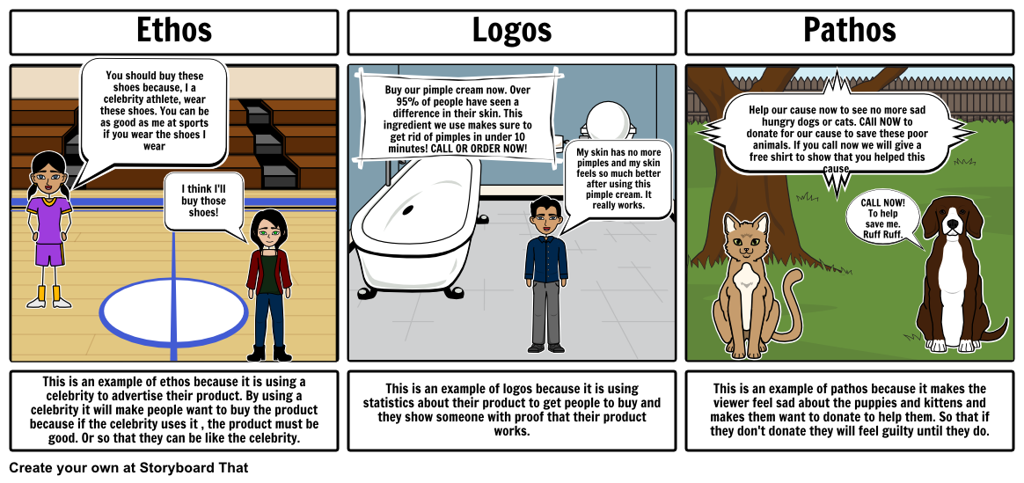

Slide 29

Ethos, Pathos and Logos Work Together
If the speaker/writer can convince the audience that they are credible, then ethos is persuasive.
If the speaker/writer can incite emotion in the audience, then pathos is persuasive.
If the speaker/writer can convince the audience that the argument is logical (even if it is actually falacious), then logos is persuasive.

Slide 30
Reading for Thursday
I Have a Dream by Martin Luther King, Jr. (p. 187)
Strategic Inquiry – Appreciative Intent: Inspiration to SOAR – A New Framewwork for Strategic Planning by Jacqueline Stavros, David Cooperrider, and D. Lynn Kelly (p. 192)

